Slide 1

I sell Medicare Now What
How to Get ‘Em--- Love ‘Em and Keep ‘Em

Slide 2
disclaimer
There is no Right Way or Wrong Way !!
It’s YOUR Way

Slide 3


Mind your own business

Slide 4
Before you get clients – get yourself ready!
Get a Budget
How much to spend on:
Advertising
Marketing – Promotional Items
Technology and Social Media

Slide 5
Your Presentation
What does your presentation look like??
What do you take with you to clients??
What does your Business card say about you??

Slide 6

Let’s start with you
What does your Business Card say about you?
Does it tell someone what you do?
Your card should have the word Medicare somewhere on it
If someone ask you for a card…. Give them three

Slide 7
Are you a specialist?
specialist
(ˈspɛʃəlɪst)n
1.a. a person who specializes in or devotes himself or herself to a particular area of activity, field of research, etc

Slide 8
How do you present yourself
Folders with your name and number
Brochures
Brochures for HR Directors
Let them know what to expect after the sale – helps with future phone calls
Swag – Include Refrigerator Magnets

Slide 9
Whats in your swag
Business card
Refrigerator Magnet
Emergency card
Pens
Bandaid holders, chip clips, jar opener,
magnifying glass, eyeglass cleaners
Anything that’s on sale at www.4imprint.com

Slide 10

Is all about Referrals

Slide 11
Referral Partners and
Lead Resources
Referral Partner
“Someone or group who has a continuous flow of Medicare eligible beneficiaries and refers those people to you”
Lead Resource
“Someone or group who may know someone Medicare Eligible and gives them your name”

Slide 12
Examples
Financial Planners
Other Brokers/Agents
Hairdresser, Manicurist
Your Doctor, Your Dentist
Your Family members
Disability Attorney
Networking Groups
Buying Leads and/or carrier leads

Slide 13
Events
Treat everyone the same
Turning 65
20 year old with kids – Has a Granny/PaPa
40 year old with a grandchild – has 65 Year old parents
Ever been to a meeting where son/daughter were there OR they need to ask the children their thoughts?
HR people – not 65 eligible but can you come to do a meeting
Ask for the Employee Benefits Broker name
Have Candy – pinwheels – just get them to your booth

Slide 14

A case study by Nielsen further shows that 92% of consumers responded positively to recommendations from friends, than they do to TV ads.

Slide 15
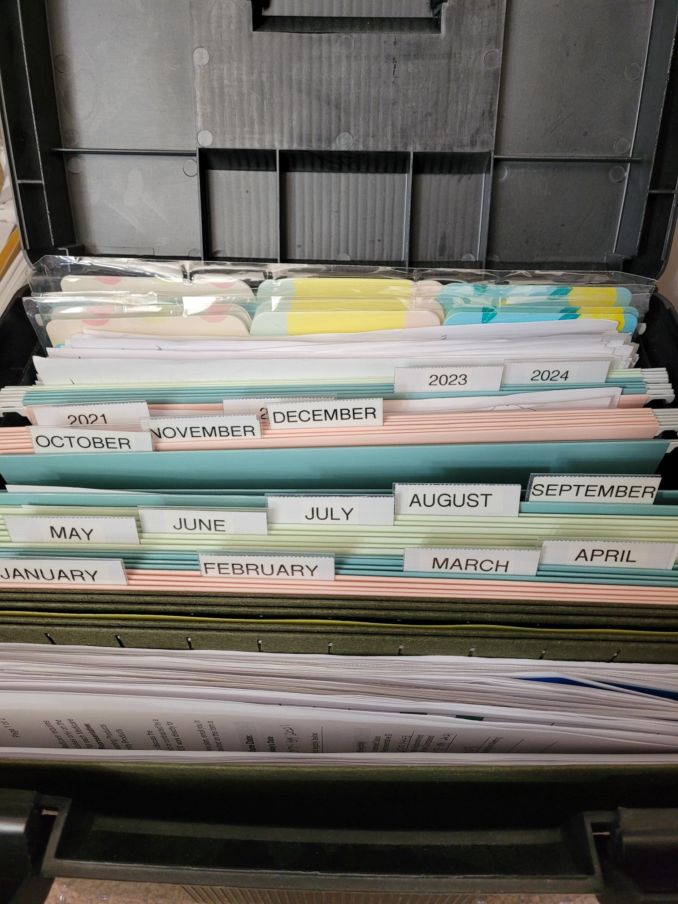
Organize your life
Review sheets
Clear Project folders
Follow up system

Slide 16
CRM– CRM---CRm---crm
Customer Relationship Management System
ZoHo
Salesforce
HubSpot
Pipedrive
Nimble

Slide 17

Don’t put your eggs all in one basket
Keep Applications in several places
Scan to CRM system
Scan to secure server
Keep paper apps
Follow all guidelines on security

Slide 18

Track your commissions
Tracking your commissions should be a priority for your agency.

Slide 19

Retention
It is 6 Times More Expensive to Win a New Customer than to Retain an Existing One
If satisfied by the customer experience, 73% of consumers will recommend a brand to others
If you’re unable to retain your customers; in other words, you churn and burn – you’ll be losing a lot of money.

Slide 20

Know y our business
Know where you get leads/referrals from
Know where they go and why

Slide 21
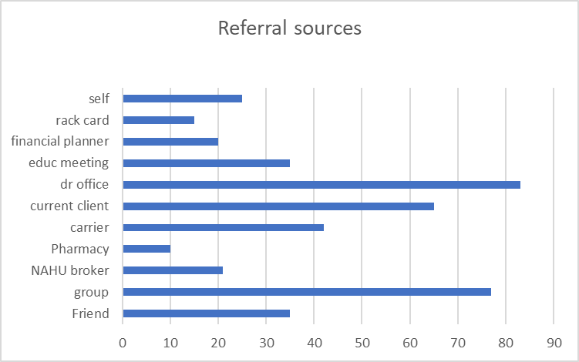

Slide 22
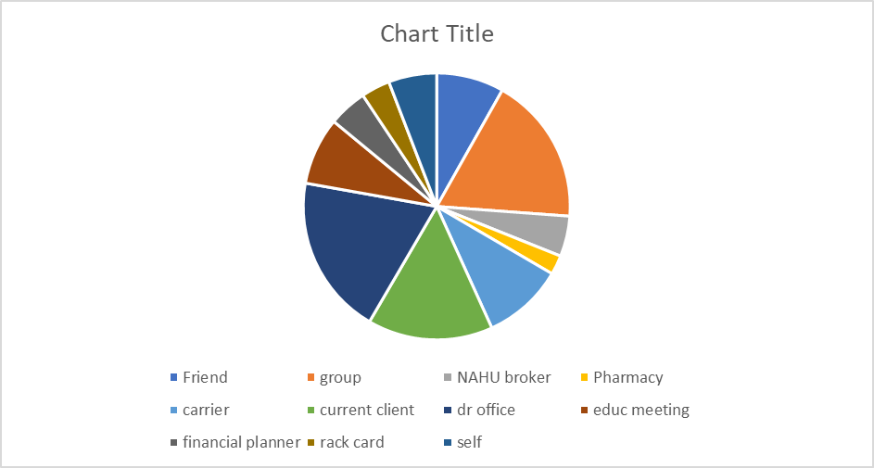

Slide 23

Greeting Card Ideas
Always always put your business card in the cards
Birthday cards
Retirement
If they call you about an illness or claim –send get well card
Sympathy cards
Colors – red, white blue

Slide 24
Build that Trust
1. Educate your customers
Sending email newsletters is still the #1 customer retention strategy that works.
With the right application, email newsletter can help you educate your customers – especially when you’re 85% focused on educating them with branded content.
2. Branded Magazine

Slide 25

Educate yourself
NAHU Resources
NAHU Broker to Broker B2B
Medicare Certification
NAHU Flyers
NAHU Medicare Portal

Slide 26
Customer retention rate formula
Calculate customer retention rate with this formula: [(E-N)/S] x 100 = CRR
Start with the number of customers at the end of the time period (E)
If you’re measuring retention for the calendar year, E is the number of customers you have on December 31.
Subtract the number of new customers gained within the time period (N)
Remember, you don’t want new customers throwing off your data, so subtract all customers you acquired in the past year from E.
Divide the result by the number of customers at the beginning of the time period (S)
In this case, S would be the number of customers on January 1 of the previous year.
Multiply by 100
The result is a percentage. Say a company had 100 customers at the start of the period (S), ended the period with 100 customers (E), and added 10 customers over the period (N). They would have a customer retention rate of 90 percent: [(100-10)/100] x 100 = 90 percent.

Slide 27

Succession PLanning
HAVE ONE!!

Slide 28
Great Reads
101 Grassroots Marketing Tips and Tricks: Rebecca Davis
In Case you get hit by a bus - Abby Schneiderman
101 Medicare Mistakes- Danielle Kunkle Roberts (NAHU Member)

Slide 29
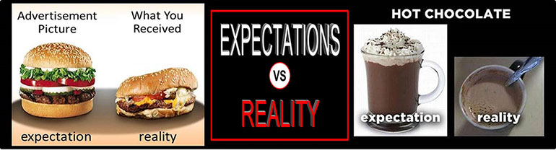
Expectations

Slide 30

“Anyone too busy to say, ‘Thank You,’ will soon have fewer chances to say it.”

