Slide 1

Medicare MSA Plans
Story to Tell & Product to Sell
Greg O’Brien

Slide 2


Opening Comments

Slide 3


Country With “Most Efficient” Healthcare System?

Slide 4



Singapore National Health Plan

Slide 5
Bloomberg World Healthcare Report
Rank | Country | Efficiency Score | Cost per Capital | Percent of GDP
1 | Singapore | 85.6 | US $2,280 | 4.3%

Slide 6
Bloomberg World Healthcare Report
Rank | Country | Efficiency Score | Cost per Capital | Percent of GDP
1 | Singapore | 85.6 | US $2,280 | 4.3%
54 | USA | 29.6 | US $10,000 | 16.8%

Slide 7
Keys to Singapore Healthcare Efficiency
Prudence
Competition

Slide 8

2020 ?????? Million People

Slide 9
30+ Million People

Slide 10

Medicare MSA Plans – HSA for Medicare?

Slide 11


Healthcare Consumerism = Prudence
More accountable.
More responsible.
Legislation to promote competition & choice.
Overall healthcare costs will decrease.

Slide 12
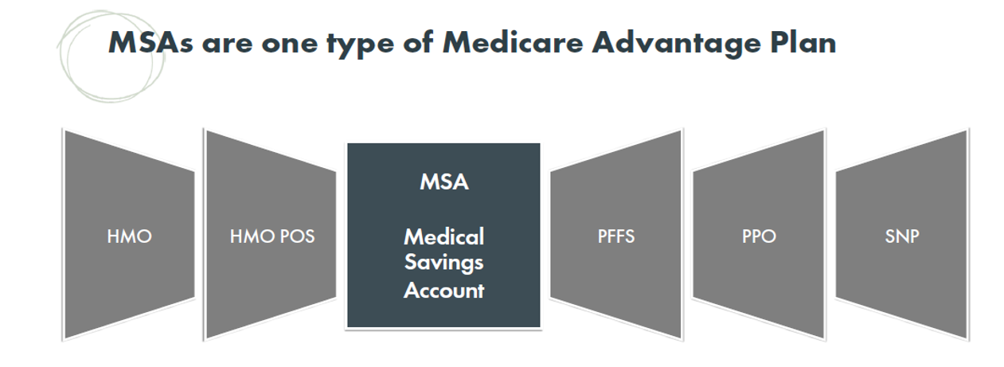


WHAT IS AN MSA?

Slide 13
5 Primary Components of Medicare MSA
Annual Deposit
$0 Monthly premium
No network restrictions
Only Pay Medicare Allowed Amounts
100% Medicare Coverage after Annual Deductible met
Notes:
MSA Plans combine a high-deductible Medicare Advantage Plan and a trust or custodial savings account (as defined and/or approved by the IRS). The plan
deposits money from Medicare into the account. You can use this money to pay for your health care costs, but only Medicare-covered expenses count toward
your deductible. The amount deposited is usually less than your deductible amount, so you generally have to pay out-of-pocket before your coverage begins.
[CMS REQUIRED DISCLAIMER].
Each member in the same region receives the same deposit amount; your health or age won’t affect the amount.
Although the IRS considers the MSA a “trust” or “custodial” account, this doesn’t mean someone else is in control. You own the money, and it is yours to use as
you wish and at your direction.

Slide 14

Introducing Lasso Healthcare MSA
HQ in Harrisburg, PA;
www.lassohealthcare.com
2019 - 17 states
2020 - 26 states + Wash DC
2021 - 34 states + Wash DC
+/- 2025 - 50 states & DC

Slide 15
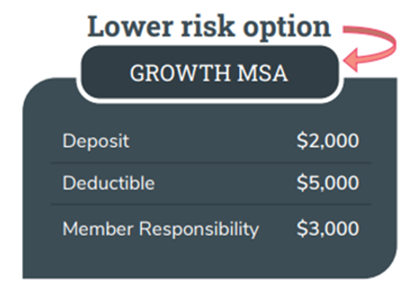
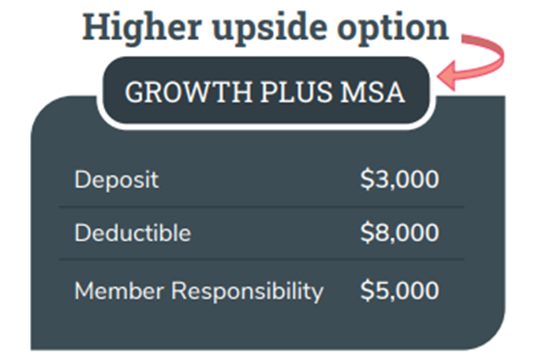
Lasso MSA Plan Designs for 2022
$2k/$5k OR $3k/$8k
Notes:
MSA Plans combine a high-deductible Medicare Advantage Plan and a trust or custodial savings account (as defined and/or approved by the IRS). The plan
deposits money from Medicare into the account. You can use this money to pay for your health care costs, but only Medicare-covered expenses count toward
your deductible. The amount deposited is usually less than your deductible amount, so you generally have to pay out-of-pocket before your coverage begins.
[CMS REQUIRED DISCLAIMER].
Each member in the same region receives the same deposit amount; your health or age won’t affect the amount.
Although the IRS considers the MSA a “trust” or “custodial” account, this doesn’t mean someone else is in control. You own the money, and it is yours to use as
you wish and at your direction.

Slide 16
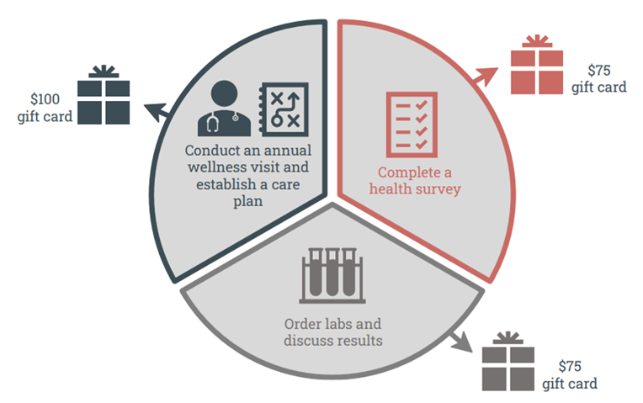
$250 Gift Cards Bonus

Slide 17
How Does Lasso MSA Work?
Confirm Willing Medicare Provider
Complete Visit – NO COPAY
Provider Sends Bill to Lasso Healthcare
Lasso adjudicates to Medicare Allowed Amount
Lasso sends billing instructions to Provider
Member pays Provider
>$5,000 Medicare costs, Lasso pays 100%

Slide 18

EXPLAIN THE MATH – Fixed Costs

Slide 19
EXPLAIN THE MATH – Fixed Costs

Slide 20
EXPLAIN THE MATH – Fixed Costs

Slide 21
EXPLAIN THE MATH – Fixed Costs

Slide 22
WHO CHOOSES A LASSO MEDICARE MSA?
Have Existing HSA Balance
Demand “Catastrophic Coverage”
Ability to Choose Willing Providers
Understand the financial risk
Notes:
An MSA offers a combination of features unique to Medicare Advantage:
• An MSA is the only Medicare product that gives you money, and is the only product where you can potentially grow that money over time.
• It offers the broadest provider choice…any provider accepting Medicare. Lasso Healthcare MSA has no provider network, removing any in-network/out of-
network decisioning.
• Your MSA bank account funds can be used to pay any Qualified Medical Expense under IRS rules, tax-free. These Qualified Medical Expenses cover more than just Medicare Parts A and B, enhancing and expanding your overall health care coverage.

Slide 23

EXPLAIN THE MATH – LOW Utilization

Slide 24
EXPLAIN THE MATH – LOW Utilization

Slide 25
EXPLAIN THE MATH – LOW Utilization

Slide 26

EXPLAIN THE MATH – LOW Utilization

Slide 27
EXPLAIN THE MATH – LOW Utilization

Slide 28

EXPLAIN THE MATH – MAXIMUM Utilization

Slide 29
EXPLAIN THE MATH – MAXIMUM Utilization

Slide 30
EXPLAIN THE MATH – MAXIMUM Utilization

Slide 31

EXPLAIN THE MATH – MAXIMUM Utilization

Slide 32
WHO CAN’T HAVE LASSO MEDICARE MSA?
Live outside of Lasso Service Area (34 States & DC)
Have other health coverage that pays Parts A & B Expenses i.e. employer, TRICARE, the VA or FEHBP
Anyone eligible for Medicaid
Anyone receiving Hospice Benefits
Notes:
An MSA offers a combination of features unique to Medicare Advantage:
• An MSA is the only Medicare product that gives you money, and is the only product where you can potentially grow that money over time.
• It offers the broadest provider choice…any provider accepting Medicare. Lasso Healthcare MSA has no provider network, removing any in-network/out of-
network decisioning.
• Your MSA bank account funds can be used to pay any Qualified Medical Expense under IRS rules, tax-free. These Qualified Medical Expenses cover more than just Medicare Parts A and B, enhancing and expanding your overall health care coverage.

Slide 33

Clinical Access with Lasso MSA
No Network Restrictions
See Any Willing Medicare Participating Provider
See Any Willing Non-Participating Provider, but Pay Excess Charges
AVOID “Opt-Out” Medicare Providers

Slide 34
WHY PEOPLE CHOOSE MEDICARE MSA?
Build Savings of Tax-Free Money from Medicare
$0 Monthly Premium
No Network Restrictions
Only pay Medicare Approved Pricing
Choose from Available Stand-Alone PDPs
Medigap Plan F/G Premiums Getting Expensive
Notes:
An MSA offers a combination of features unique to Medicare Advantage:
• An MSA is the only Medicare product that gives you money, and is the only product where you can potentially grow that money over time.
• It offers the broadest provider choice…any provider accepting Medicare. Lasso Healthcare MSA has no provider network, removing any in-network/out of-
network decisioning.
• Your MSA bank account funds can be used to pay any Qualified Medical Expense under IRS rules, tax-free. These Qualified Medical Expenses cover more than just Medicare Parts A and B, enhancing and expanding your overall health care coverage.

Slide 35
WHY AGENTS SHOULD SELL MSA Plans?
Lifetime Commission$ Paid Like All MAPDs
Simple Online Enrollment Process
Leads and Clients Will be Hearing About MSA Plans
Use as Tool to Educate Financial Advisors, CPAs
Educate Employers about Attractive Option for Medicare Eligibles
Get Additional PDP Commission$
Notes:
An MSA offers a combination of features unique to Medicare Advantage:
• An MSA is the only Medicare product that gives you money, and is the only product where you can potentially grow that money over time.
• It offers the broadest provider choice…any provider accepting Medicare. Lasso Healthcare MSA has no provider network, removing any in-network/out of-
network decisioning.
• Your MSA bank account funds can be used to pay any Qualified Medical Expense under IRS rules, tax-free. These Qualified Medical Expenses cover more than just Medicare Parts A and B, enhancing and expanding your overall health care coverage.

Slide 36
HOW AGENTS SHOULD SELL MSA’s?
Inform prospects & clients about changes in Medicare
Share Lasso MSA information with Financial Advisors & CPAs
Find prospects & clients with high Medigap premiums
Find prospects with existing HSA account balances
Position MSA funds as a “Benefits Bank” for healthcare needs
Be able to “explain the math”!
Notes:
An MSA offers a combination of features unique to Medicare Advantage:
• An MSA is the only Medicare product that gives you money, and is the only product where you can potentially grow that money over time.
• It offers the broadest provider choice…any provider accepting Medicare. Lasso Healthcare MSA has no provider network, removing any in-network/out of-
network decisioning.
• Your MSA bank account funds can be used to pay any Qualified Medical Expense under IRS rules, tax-free. These Qualified Medical Expenses cover more than just Medicare Parts A and B, enhancing and expanding your overall health care coverage.

Slide 37
SUMMARY: MEDICARE MSA PLANS
Medicare Advantage plan
Enroll AEP or ICEP
Annual Deposit in YOUR MSA Account that YOU Control
Pay for QME; Keep What You Don’t Use!
Financially Attractive with Low to Moderate Utilization

Slide 38
SUMMARY #2: MEDICARE MSA PLANS
$0 Monthly Premium
No Network Restrictions – Any Willing Medicare Provider
Only Pay Medicare Allowed Amount
Catastrophic Coverage
Choose “Best” of Stand-Alone PDPs

Slide 39


Medicare MSA Plans
A WIN – WIN – WIN Scenario
WIN for Medicare Eligibles: Save Today for Future Needs
WIN for Federal Government: Flatten Medicare Spending Curve
WIN for Medicare Agents: Lifetime MA & PDP Commissions

Slide 40


Greg O’Brien, Managing Principal
404.821.1886 greg.obrien@medicarecaddy.com

