Slide 1

10 Common and Costly Medicare Mistakes
Presented by:
Donna D. Hill, FLMI
Director of Senior and Individual Markets
E2E Benefits Services

Slide 2
72% of people over the age of 50 wish they better understood Medicare.
Medicare is a key retirement decision but seniors approaching eligibility are overwhelmed with information that ultimately just confuses them. They are left at risk of making costly, often permanent mistakes.
Here are some of the most common – and most costly – mistakes made. Take the time to understand the detrimental impact just one mistake can have.

Slide 3

Mistake # 1
NOT CONSULTING AN ADVISOR WHO CAN STEER THEM AWAY FROM MISTAKES 2-10
Even for the most intelligent and diligent researcher Medicare is confusing! Get the word out in your community that you are available and willing to advise.
“The way to get what you want is to hep enough other people get what they want” – Zig Ziglar

Slide 4

Mistake #2
NOT PURCHASING COVERAGE BEYOND PARTS A AND B
As agents we often focus our marketing efforts on those turning 65 and people who are already in a plan but want to review their coverage during open enrollment. However, there are thousands of seniors out there who don’t have supplemental coverage and don’t know how to get it other than calling Joe Namath – and we all know how well that works out.

Slide 5

Mistake # 3
BELIEVING ZERO PREMIUM MEANS ZERO COST
When explaining Medicare to a senior, I present this as “pay now or pay later”. I emphasize the costs that may be involved in a claims situation under a Medicare Advantage plan. I particularly emphasize the copay if they need an MRI (usually around $200-300), and the copay they will pay for the first 6-7 days of a hospital stay.

Slide 6
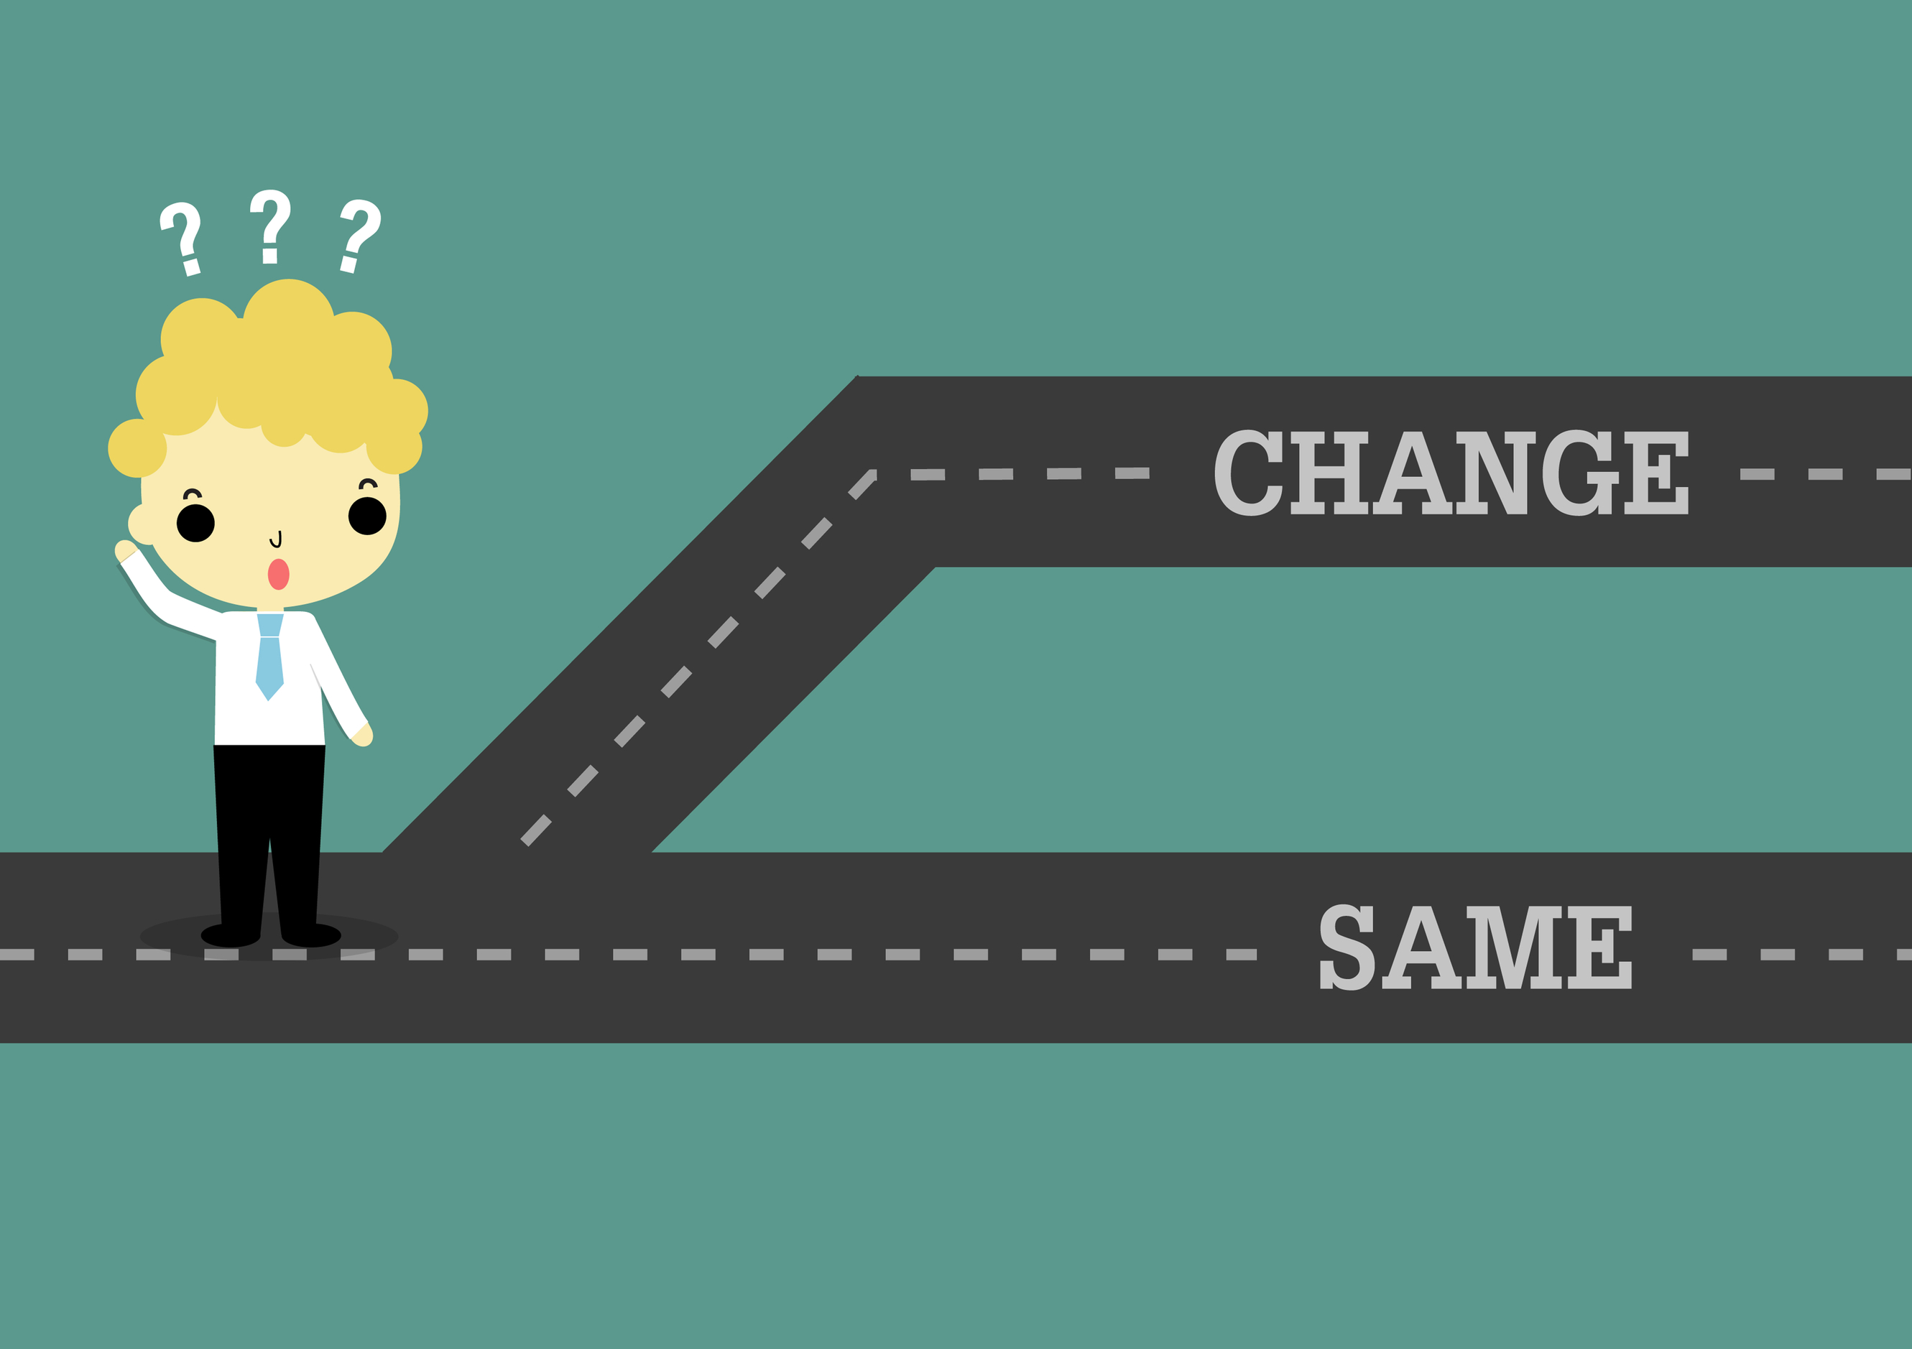
Mistake # 4
NOT REVIEWING COVERAGE ANNUALLY
Formularies change. Benefits change. Provider lists change. If you have a block of Medicare Advantage business, you need to review the plan of every client every year. Do this in October when the ANOCs come out. Even Medicare Supplement plans should be reviewed every year to see if the premium has increased out of affordability for your client.

Slide 7
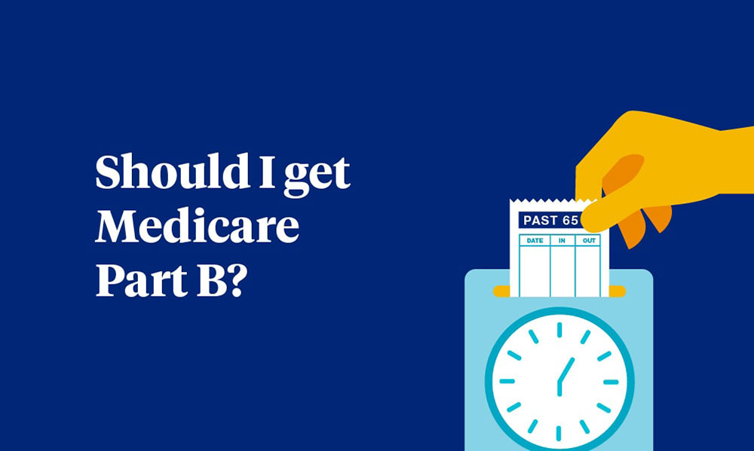
Mistake # 5
ENROLLING WHEN YOU SHOULD DELAY, OR DELAYING WHEN YOU SHOULD ENROLL
This is the question I get most often from those turning 65. Do I need to enroll in Part B? Many think that if they are not working they don’t have to enroll. However, if they are working for an employer with less than 20 employees, that’s not true. Some think that if they are healthy they can wait and enroll anytime. Also not true. Not only is there a penalty but if they found they needed coverage they would have to wait to general enrollment for coverage to be effective the following July. More about this in the next slide.

Slide 8

Mistake # 5
NOT UNDERSTANDING THE HEIRARCHY OF ENROLLMENT PERIODS
IEP/ICEP trumps all other enrollment periods. Where this creates danger is when a senior is turning 65 in, for example in October, and are planning to retire at the end of the year. You advise them to delay Part B until they retire as you do most clients in this situation. When they apply in November for Part B to be effective January 1 they find it’s not effective until February 1 leaving them without coverage for one month

Slide 9

Mistake # 8
NOT UNDERSTANDING PRIMARY PAYER LAWS
COBRA is not considered creditable coverage for purposes of Medicare. Therefore, when your COBRA expires, not only will you have to wait until General Enrollment (Jan-Mar) to enroll for an effective date the next July, but you will also incur a penalty for life

Slide 10
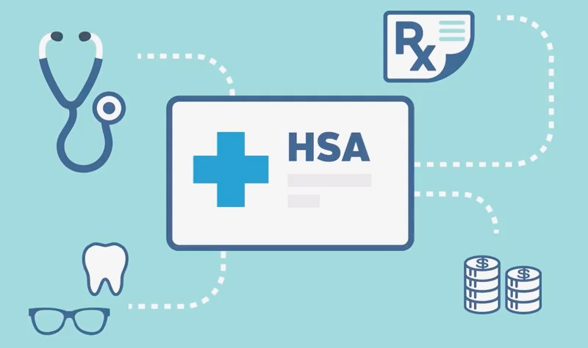
Mistake # 9
Continuing HSA contributions after ANY PART of Medicare becomes effective. This includes Part A. Any money contributed after the Medicare effective date is subject to a 6% excise tax. Any match by the employer must also be returned.

Slide 11
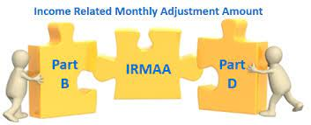
Mistake # 10
NOT UNDERSTANDING THE IMPACTS OF IRMAA
You retire at age 65 and enroll in Medicare. Your income was less than $176,000 for you and your spouse so you are paying the standard premium for Part B. At age 68, you convert a large IRA to a Roth IRA. This significantly increases the amount on your tax return that is used to calculate IRMAA, causing your Medicare Part B premium to go up by $433.50 per month – or $5,202 per year.

Slide 12

Mistakes like these cost Americans more than $6.4 billion annually. But with advice of a trusted advisor they don’t have to.
BE THAT ADVISOR!

Slide 13


